Slide 1
FUNDAMENTAL OF MEMORY TESTING
Chapter 1 - Introduction

Slide 2
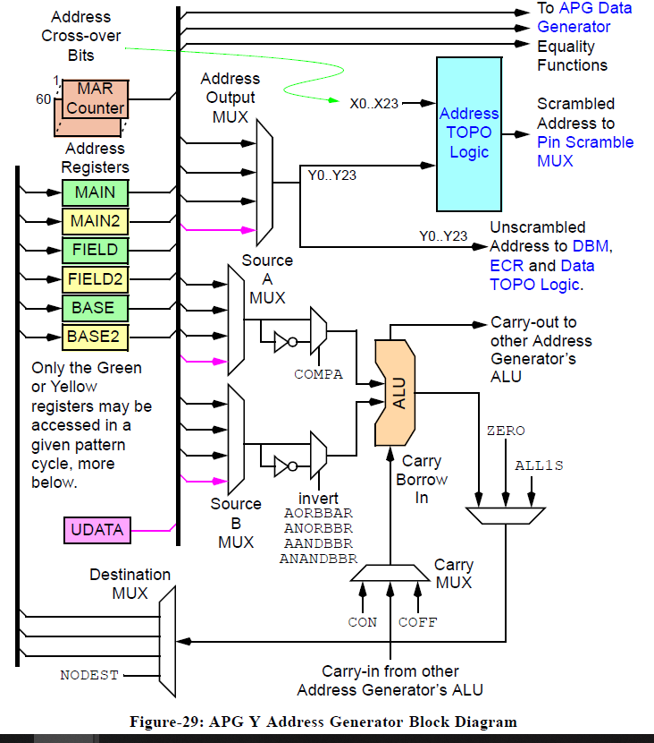
Fundamental Of Memory Testing
Notes:
is 3620 xeon or i7?

Slide 3
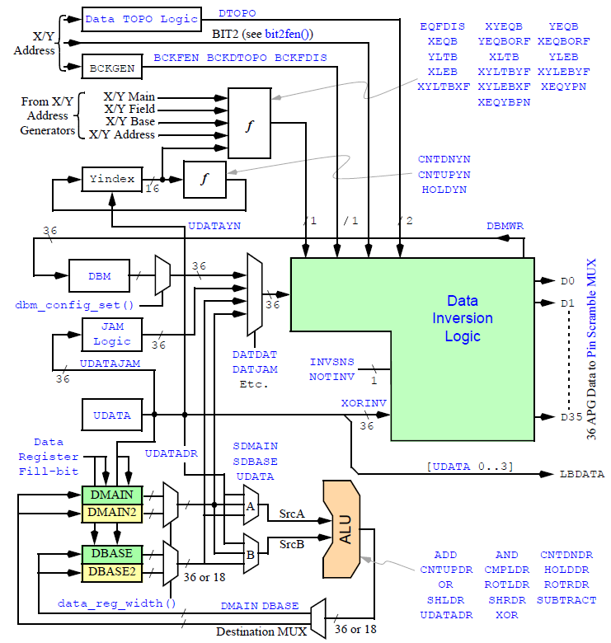
Fundamental Of Memory Testing
Notes:
is 3620 xeon or i7?

Slide 4
Fundamental Of Memory Testing
Notes:
https://www.youtube.com/watch?v=EI30GQPEZ6I

Slide 5
Fundamental Of Memory Testing
XALU SourceA, SourceB, Carry/Borrow, Function, Destination(s), Addressout
YALU SourceA, SourceB, Carry/Borrow, Function, Destination(s), Addressout
DATGEN SrcA, SrcB, Dest, Drfunc, Yindex, Eqfunc, Bckfunc, Invsns, Dataout, Udatajam, Dbmwr
COUNT Counter, Function, Autoreload
Notes:
https://www.youtube.com/watch?v=EI30GQPEZ6I

Slide 6
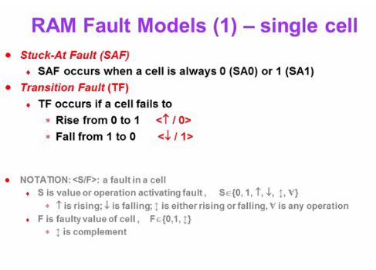
Fundamental Of Memory Testing
Notes:
https://www.youtube.com/watch?v=EI30GQPEZ6I

Slide 7
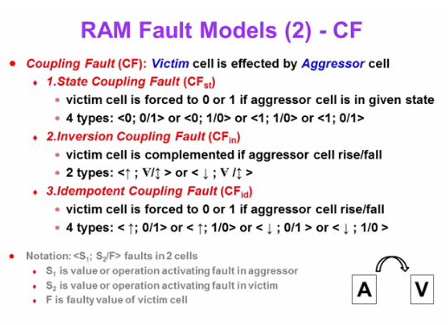
Fundamental Of Memory Testing
Notes:
https://www.youtube.com/watch?v=EI30GQPEZ6I

Slide 8
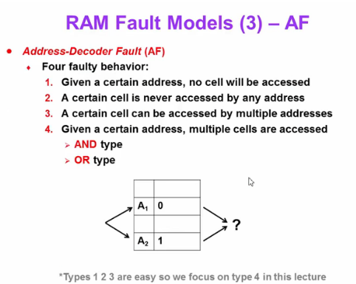
Fundamental Of Memory Testing

Slide 9
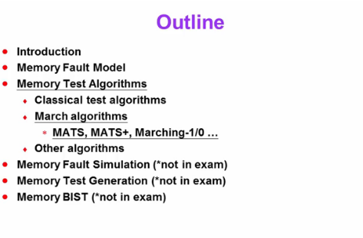
Fundamental Of Memory Testing

Slide 10
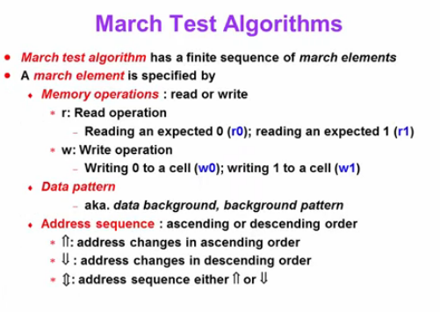
Fundamental Of Memory Testing

Slide 11
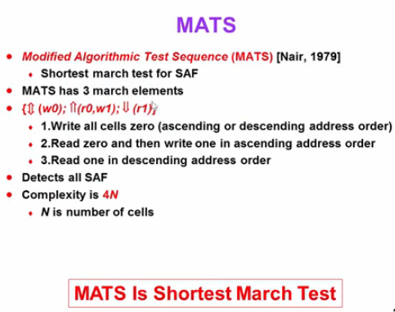
Fundamental Of Memory Testing

Slide 12
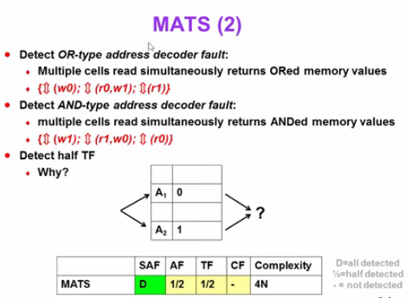
Fundamental Of Memory Testing

Slide 13
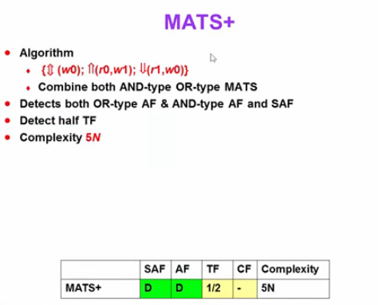
Fundamental Of Memory Testing

Slide 14
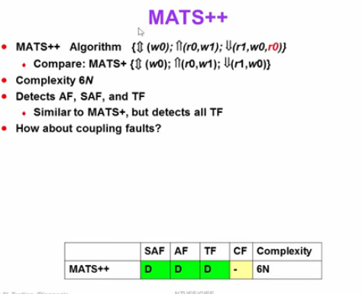
Fundamental Of Memory Testing

Slide 15
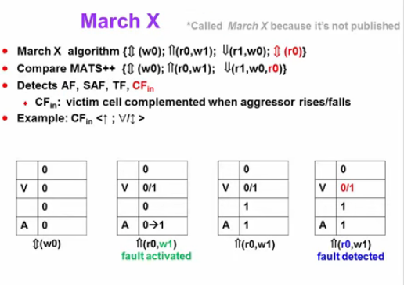
Fundamental Of Memory Testing

Slide 16
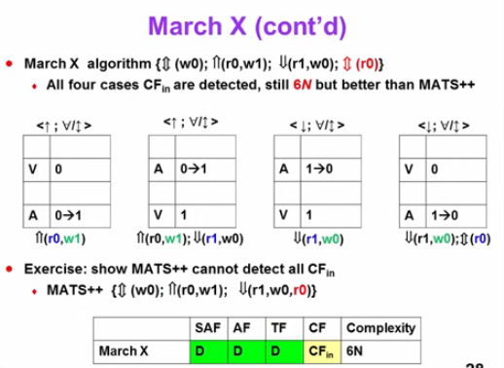
Fundamental Of Memory Testing

Slide 17
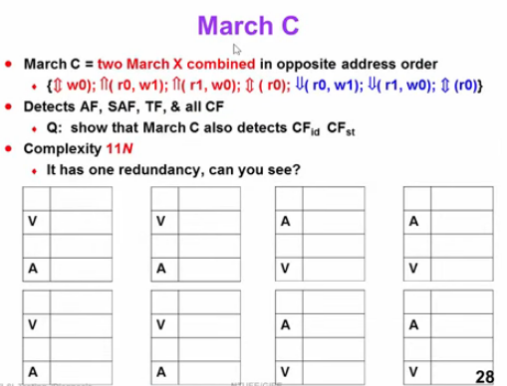
Fundamental Of Memory Testing

Slide 18
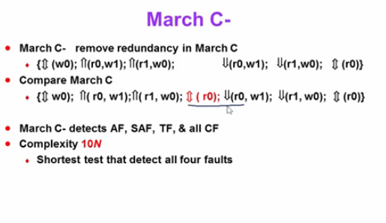
Fundamental Of Memory Testing

Slide 19
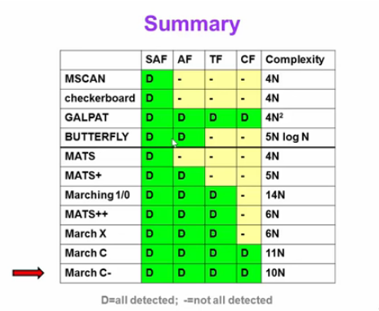
Fundamental Of Memory Testing

